Slide 1
SEIS 6XX IT Infrastructure Week 1
Jason Baker
Adjunct Instructor
Graduate Programs in Software
University of St. Thomas
St. Paul, MN

Slide 2
Agenda
Introduction to the course
Review syllabus
Source control management & Git

Slide 3
About Your Instructor
2015 Graduate of UST GPS program in Software Engineering
20+ years in IT working mainly with Internet startups
Technical co-founder of a large regional datacenter and managed hosting company
AWS Certified Solutions Architect & Developer
Hobbies include underwater photography, cycling, and building analog music synthesizers

Slide 4
Course Introduction
What do we mean by “infrastructure”?
IT infrastructure provides all the necessary hardware and software components necessary to deliver a service.
Almost every software application consumes some amount computation power, data storage, and network bandwidth.
We usually don’t think about infrastructure… until it fails.

Slide 5
IT Service Stack
Software applications
Application Servers (Web/Database/Messaging)
Operating System/ Virtual Instance/ Container
Compute
Network
Storage
Data center

Slide 6
Our focus in this course
Software applications
Application Servers (Web/Database/Messaging)
Operating System/ Virtual Instance/ Container
Compute
Network
Storage
Data center

Slide 7
Change in IT Infrastructure
The way IT organizations are acquiring, provisioning, and maintaining infrastructure is rapidly changing.
IT Infrastructure needs to be as agile and flexible as modern software applications.

Slide 8
Change is being driven by…
Commoditization of compute/storage/network
Widespread adopt of virtualization
Cloud computing business models
Modern application architecture
Agile and LEAN practices

Slide 9
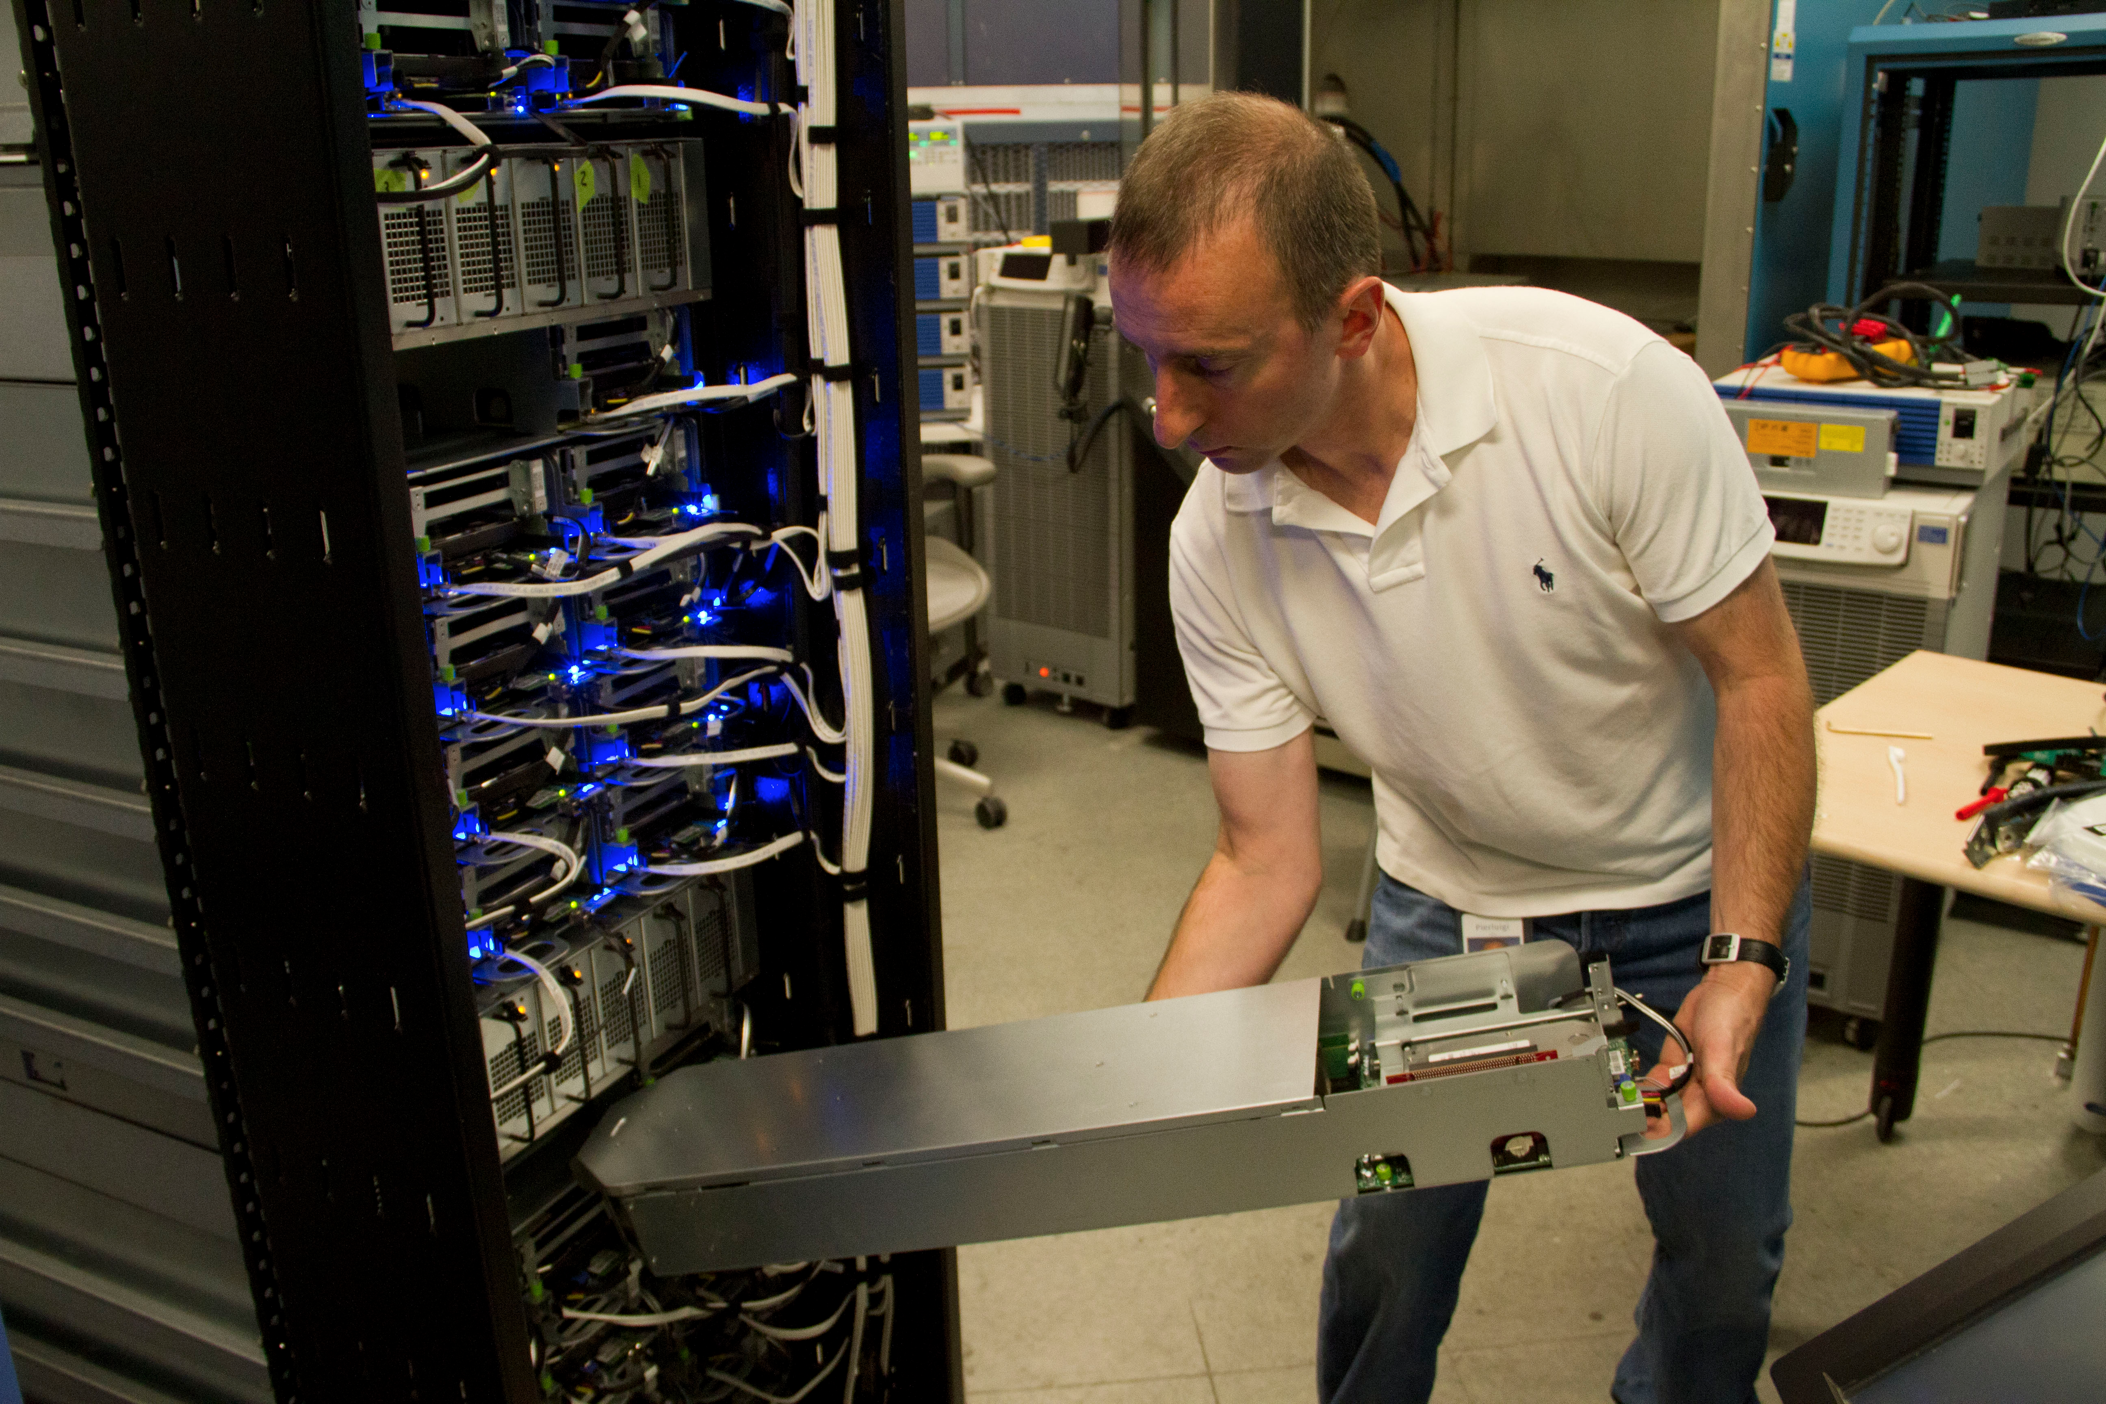
The traditional way of building servers
Hand crafted,
physical systems
requiring multiple
skills to provision.
The dominant form of infrastructure today.

Slide 10
The traditional way
The server build process:
Purchase request
Receive components
Build server
Test build/ Update firmware
Install OS/Hypervisor
Test server
Rack server
Networking/ load balancing provisioning
Storage provisioning
Firewall provisioning
Backup/ Monitoring provisioning
Disaster recovery provisioning
Security testing
Application server installation
Software installation
Software testing
1 to 6 months later you have a server!

Slide 11
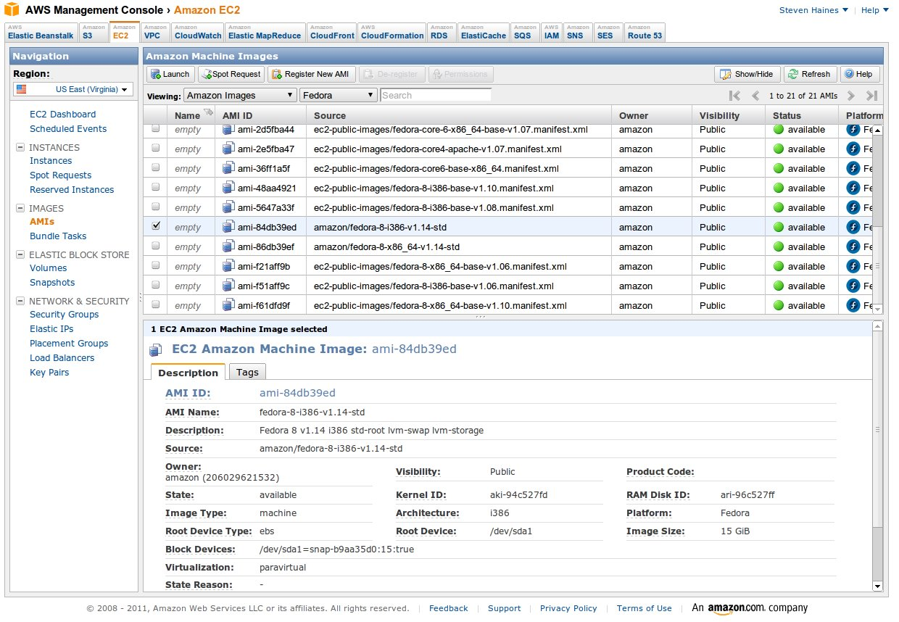
The new way
Scripted,
automated
infrastructure
available on
demand from a
global cloud
computing service.
The fastest growing form of infrastructure today.

Slide 12
The new way
The server build process*:
Review and request computing budget
Select predefined infrastructure stack
Deploy stack into virtual data center
Automatically load application and data
5 minutes later you have a server!
* This can all be automated.

Slide 13
We will focus on the new way
Topics this semester:
Server management
Source control management
Package management
Shell scripting
Cloud computing
Virtualization
Configuration Management
Containers
DevOps
Data centers

Slide 14
Let’s review the course syllabus

Slide 15
Review syllabus
Notes:
This is a survey course and it will not turn you into an IT professional in 4 months.
Nobody is a true expert in all of these topics, including me. Share your knowledge and experience with the class.
Assignments will start out very prescriptive at first, but become less so over time.
I want this course to challenge you. ☺

Slide 16
Review syllabus
Caveats
This is a new course and we are all beta testers. I appreciate your patience and feedback.
Syllabus is subject to change based on how much material we get through.

Slide 17
Source Control Management
Definition: “A component of software configuration management, version control, also known as revision control or source control, is the management of changes to documents, computer programs, large web sites, and other collections of information.” – Wikipedia
In our world, source control is simply a database that stores all the changes made to a set of text files.

Slide 18

Source Control Management
We use source control systems to:
Store and track changes in software source code and application configurations (or most any sort of text-based artifact)
Maintain different releases of software code
Test different versions of software
Effectively collaborate as a team on a single set of artifacts
Isn’t this source control stuff just for developers?

Slide 19
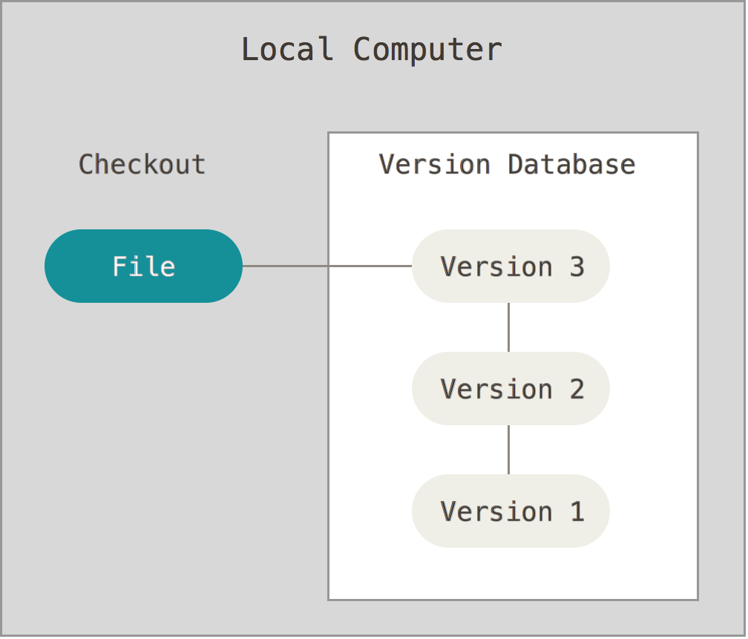
Types of source control
Local
Simple file
versioning
RCS
Image from https://git-scm.com/book/en/v2/Getting-Started-About-Version-Control

Slide 20
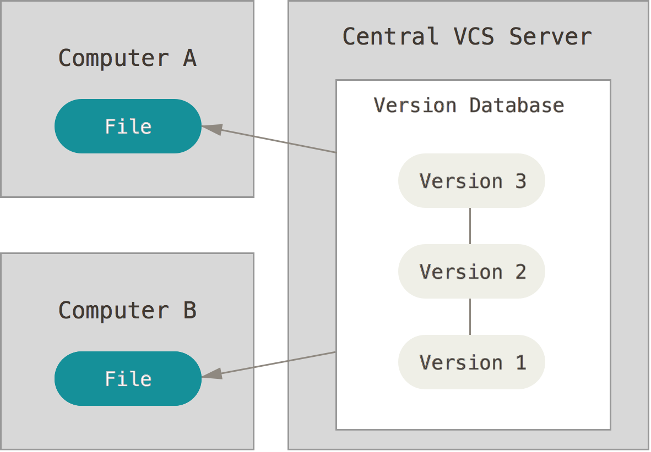
Types of source control
Centralized
Team approach
Everyone works
on same files
Server = single
point of failure
Hard to branch
Subversion
Image from https://git-scm.com/book/en/v2/Getting-Started-About-Version-Control

Slide 21
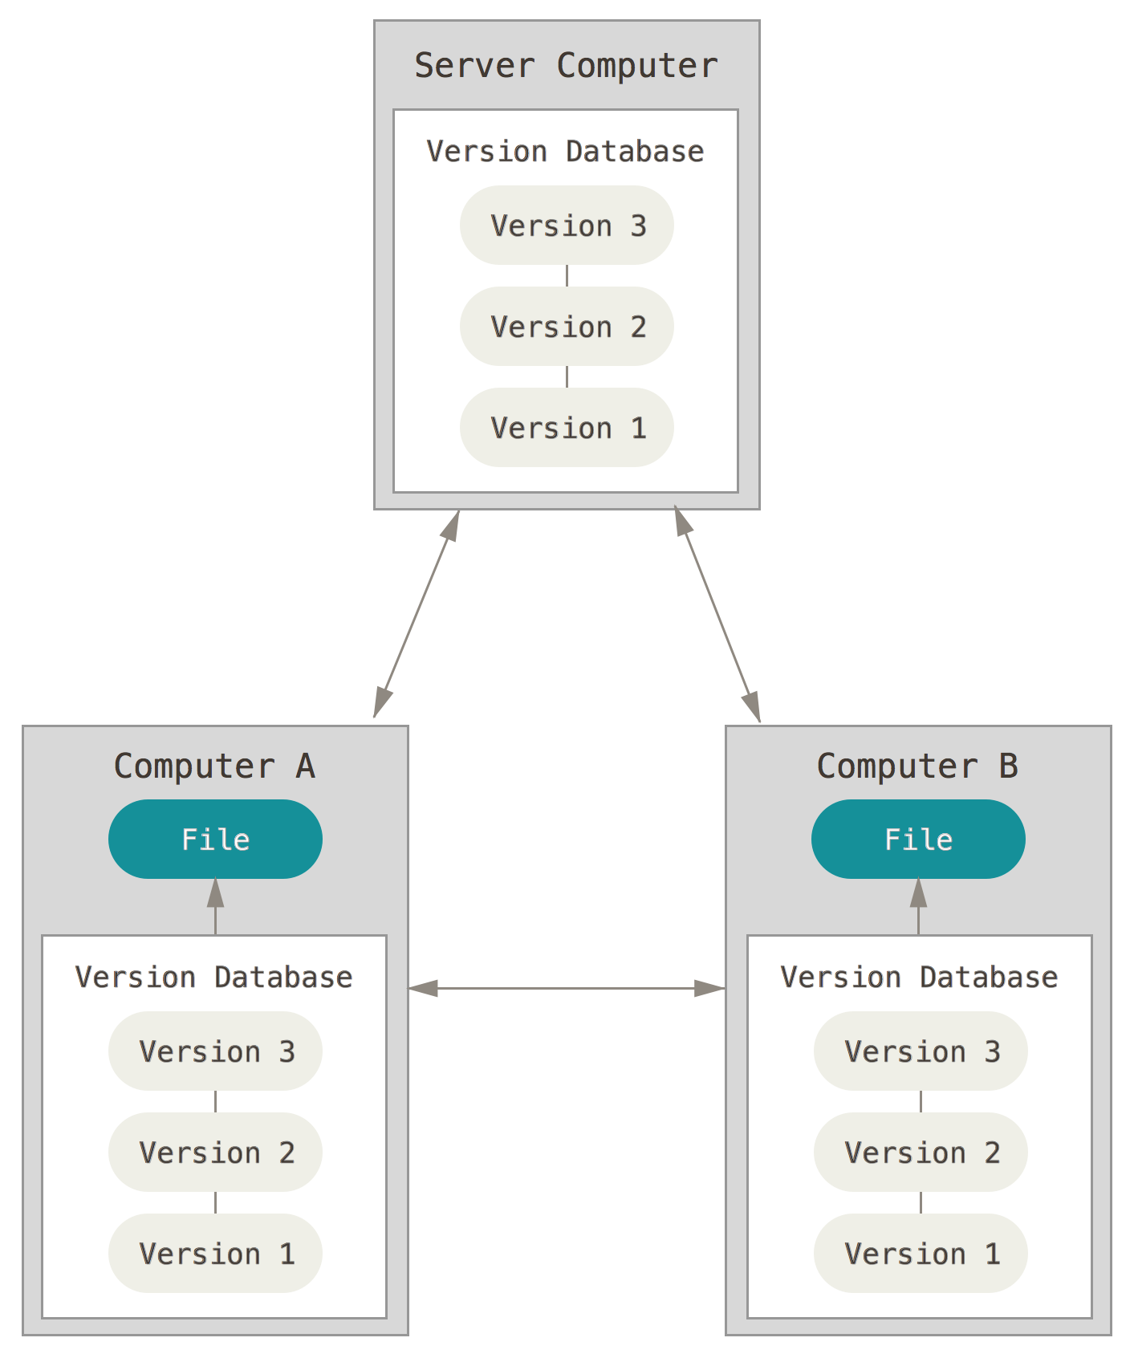
Types of source control
Distributed
Team approach
Everyone works
on their own files
Easy to branch
Need to handle merge
conflicts
Git
Image from https://git-scm.com/book/en/v2/Getting-Started-About-Version-Control

Slide 22
Git
Most popular distributed source control management system
Open Source
Initially designed by Linus Torvalds (Linux) in 2005
Goals:
Super fast patching
Supports one developer or thousands of developers
Designed from a file-system perspective, not a source control management perspective

Slide 23
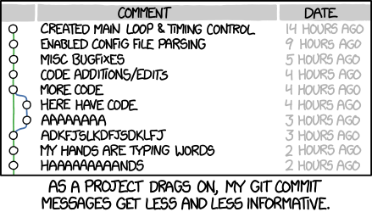
How Git Works
A series of file system (directory) snapshots over a period of time

Slide 24
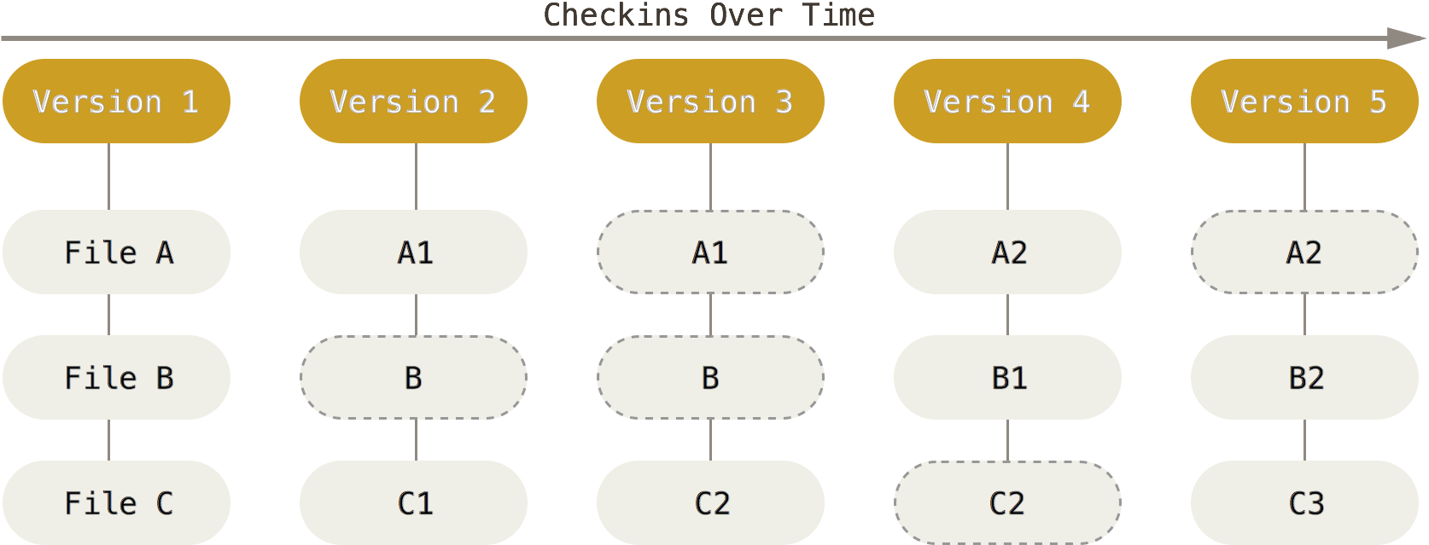
How Git Works
Data never duplicated and changes stored as deltas
Image from https://git-scm.com/book/en/v2/Getting-Started-Git-Basics

Slide 25
How Git Works
Nearly every operation is local
You modify your local files and then “push” them up to a central server
You can pull files down from a central server to synchronize with team members
Constant cycle of developing->pulling->rebasing->pushing
All changes in Git are recorded with a hash
Almost everything is additive, it’s hard to delete anything from Git by design

Slide 26
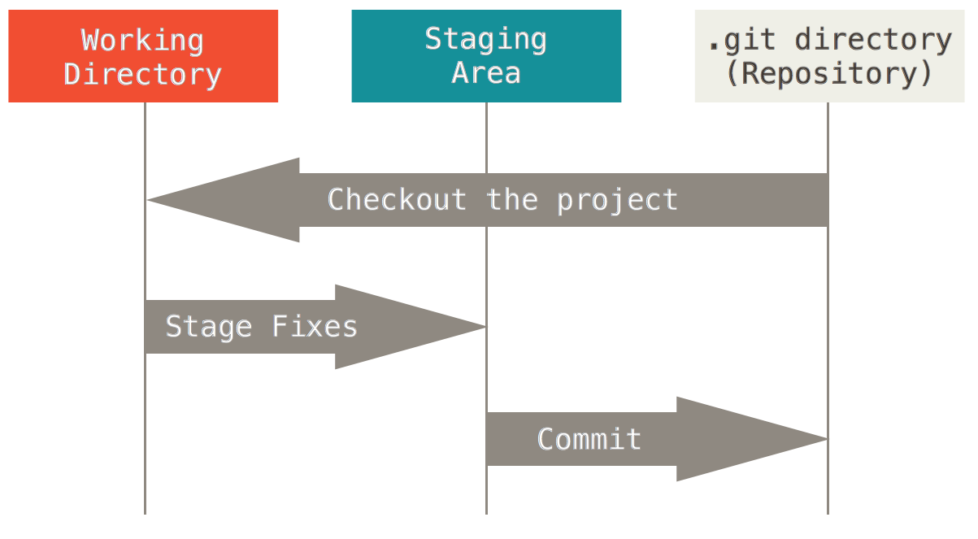
How Git works
Files in a Git directory (repository) are in one of three states:

Slide 27
Let’s start playing with Git
The best way to learn Git is by using the git command using a command line interface (terminal shell)
You can also use graphical Git clients such as Source Tree
Refer to Git Hands-On document
Book: https://git-scm.com/book/en/v2

Slide 28
Homework
Assignment 1: Set up accounts
Read Web Operations Chapter 1
Read Practice of Cloud Systems Administration Chapter 12, sections 12.1-12.6
Read Git Hands On Guide
Start reading Linux Hands On Guide

